Slide 1
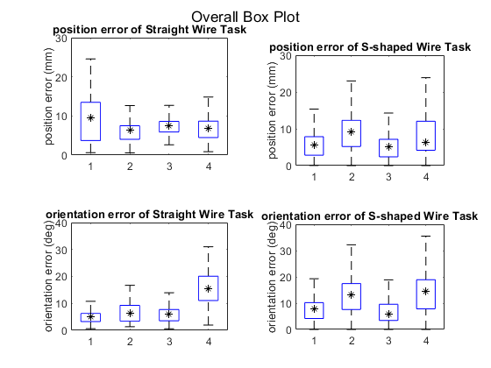
* Mean
User 1
MTM
User 1
IMU
User 2
MTM
User 2
IMU
User 1
MTM
User 1
IMU
User 2
MTM
User 2
IMU
User 1
MTM
User 1
IMU
User 2
MTM
User 2
IMU
User 1
MTM
User 1
IMU
User 2
MTM
User 2
IMU

